Slide 1

Sales Performance
Analysis Report
Abdulrahman Mohamed Doma Basant Mohamed Ali Ahmed Khalifa

Slide 2
Data-Driven Insights
Sales Performance
Analysis Report
Comprehensive Data-Driven Insights for Strategic Decision Making
2011-2014 Analysis Period
Multi-Dimensional Sales Data

Slide 3
Navigation
Executive Overview
01
Key Performance Indicators
02
Product Category Performance
Core business metrics and financial health assessment
Sales distribution and category contribution analysis
03
Regional Sales Distribution
04
Channel Performance Analysis
Geographic market penetration and growth opportunities
Multi-channel sales effectiveness and optimization
05
Temporal Trends
06
Brand Performance
Seasonal patterns and year-over-year growth analysis
Brand ranking by sales volume and market positioning
07
Strategic Insights & Recommendations
Actionable strategies for sustainable growth and market expansion

Slide 4
Section 01
Executive Summary: Key Performance Indicators
Total Sales
Total Profit
Profit Margin
Total Quantity
$8bn
$5bn
57%
37M
Revenue across all channels
Net profit after costs
Industry-leading efficiency
Units sold globally
Total Orders
Return Value
Total Discount
628K
$29M
$40M
Transaction volume
0.36% of total sales
0.50% of total sales
Business Health Assessment: With a 57% profit margin and strong sales performance, the business demonstrates exceptional operational efficiency. Return and discount rates remain minimal, indicating high customer satisfaction and effective pricing strategies.

Slide 5
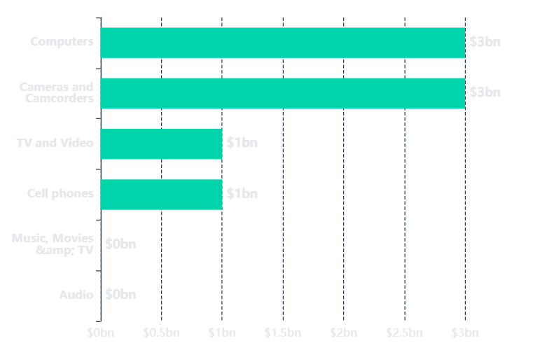
Section 02
Product Category Performance Analysis
Sales by Product Category
Category Insights
Dominant Categories
Computers and Cameras & Camcorders each contribute $3bn, representing 75% of total sales
Secondary Performance
TV & Video and Cell Phones generate $1bn each, showing solid market presence
Underperforming Segments
Music/Movies/TV and Audio show minimal contribution, indicating potential divestment opportunities
Category Concentration Risk
High
Top 2 categories = 75% of revenue
Total Categories
Active Contributors
Revenue Concentration
6
4
75%

Slide 6
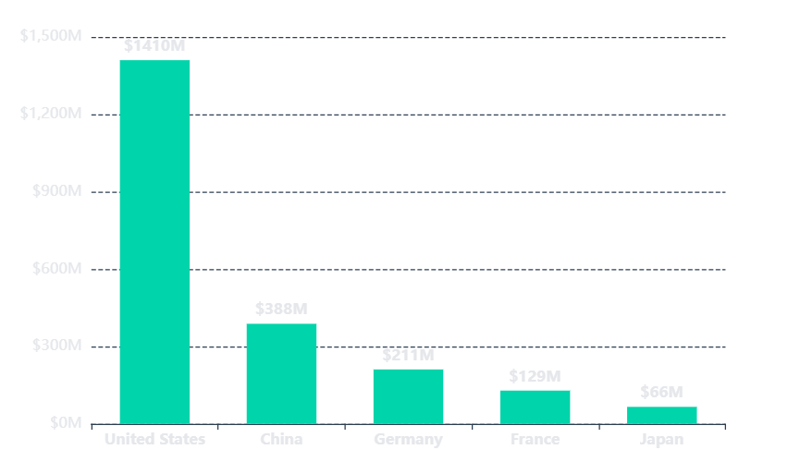
Section 03
Regional Sales Distribution: Global Perspective
Sales by Country
Market Leadership
🇺🇸
United States
$1.41bn
Market Leader
🇨🇳
China
$388M
Strong Growth
🇩🇪
Germany
$211M
European Hub
Geographic Insights
• US Dominance: Represents 50%+ of top 5 market revenue
• Asia-Pacific: China shows strong second position
• Expansion Opportunity: Emerging markets underrepresented
USA Share
China Share
Europe Share
Japan Share
Others
63%
17%
15%
3%
2%

Slide 7
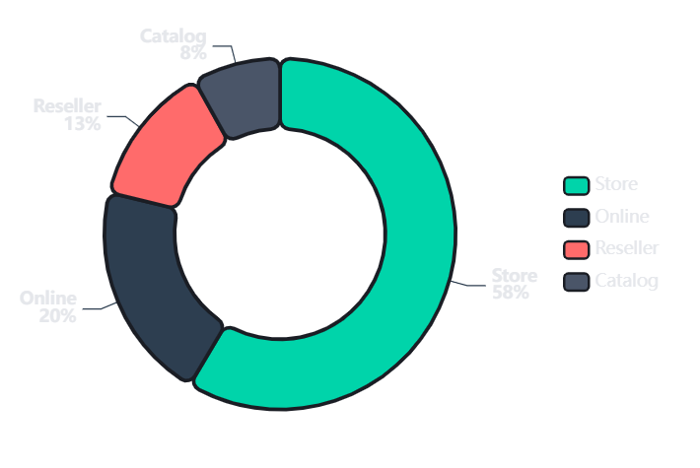
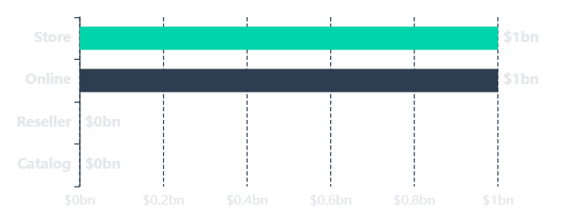
Section 04
Channel Performance Analysis
Sales Distribution by Channel
Sales by Store Type
Channel Strategy Insights
Physical Dominance: Store channel leads with 58% market share, indicating strong retail presence
Digital Growth: Online represents 20% - significant opportunity for expansion
Underperformers: Reseller (13%) and Catalog (8%) channels need optimization
Store Revenue
Online Revenue
Reseller Revenue
Catalog Revenue
$1bn
$1bn
$0bn
$0bn
58% share
20% share
13% share
8% share

Slide 8
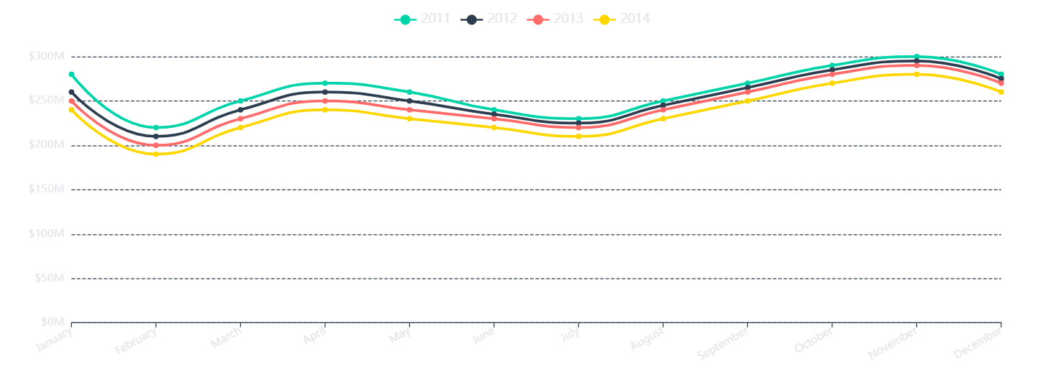
Section 05
Temporal Sales Trends (2011-2014)
Peak Season
Growth Pattern
Low Period
Volatility
October-December consistently shows highest sales across all years
2011 shows strongest baseline; subsequent years demonstrate stability
February-March typically shows seasonal dip requiring promotional support
Moderate month-to-month variation indicates stable demand patterns

Slide 9
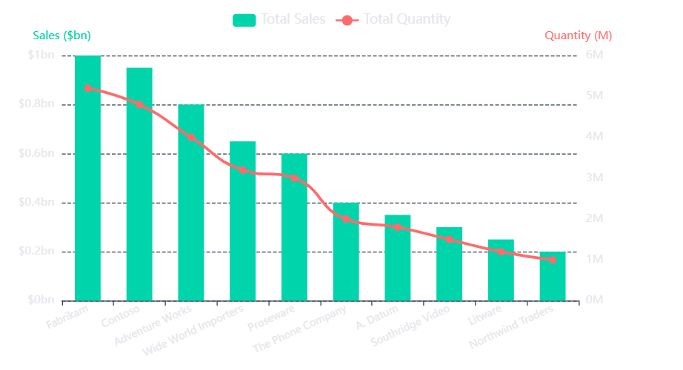
Section 06
Brand Performance Analysis
Brand Ranking: Sales vs Quantity
Top Performers
1
Fabrikam
Market Leader
2
Contoso
Strong Challenger
3
Adventure Works
Consistent Growth
Brand Portfolio Insights
• Top 3 brands drive majority of revenue
• Long tail of smaller brands shows diversification
• Opportunity to optimize underperforming brands
Total Brands
Top 3 Share
Leader Margin
Bottom 5 Share
Avg per Brand
12
68%
~$1bn
12%
$0.7bn

Slide 10
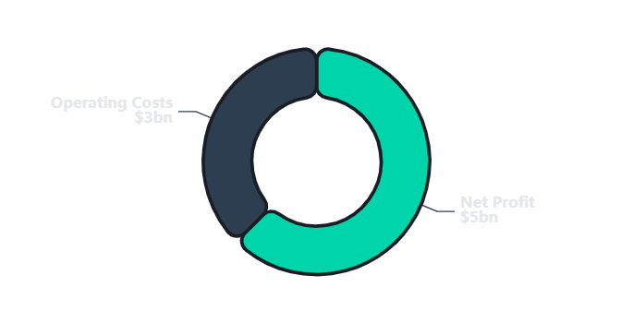
Section 07
Profitability & Operational Metrics
Financial Health Dashboard
Revenue to Profit Flow
Profit Margin
57%
Industry benchmark: 35-45%
Return Rate
0.36%
Industry average: 8-12%
Discount Rate
0.50%
Industry average: 15-25%
Key Performance Highlights
Operational Excellence
Exceptional Profitability: 57% margin significantly exceeds industry standards
628K
$12.7K
Low Return Rate: 0.36% indicates high product quality and customer satisfaction
Minimal Discounting: 0.50% shows strong pricing power and brand value
Total Orders
Avg Order Value
High AOV: $12.7K average order value demonstrates premium positioning

Slide 11
Section 08
Strategic Insights & Recommendations
Risk: Category Concentration
Opportunity: Geographic Expansion
Challenge: 75% of revenue depends on just two product categories (Computers & Cameras), creating significant vulnerability to market shifts.
Insight: US market dominates with 63% share, while emerging markets remain underpenetrated, representing untapped potential.
Recommendation:
Recommendation:
Diversify product portfolio by investing in emerging categories and expanding offerings in underperforming segments.
Develop targeted market entry strategies for high-growth regions in Asia-Pacific and Latin America.
Opportunity: Digital Channel Growth
Strength: Profitability Leverage
Insight: Online channel represents only 20% of sales despite global e-commerce growth trends, indicating expansion potential.
Advantage: 57% profit margin provides substantial financial flexibility for strategic investments and competitive initiatives.
Recommendation:
Recommendation:
Invest in digital infrastructure, e-commerce optimization, and omnichannel integration to capture online market share.
Leverage strong margins to fund R&D, market expansion, and brand building while maintaining profitability.
Strategic Priority: Balance short-term profitability with long-term diversification to build a resilient, sustainable business model capable of weathering market volatility.

Slide 12

Data-Driven Decisions
for Growth
The analysis reveals a profitable, well-performing business with clear opportunities for diversification and channel optimization. Leverage these insights to drive strategic initiatives and sustainable growth.
$8bn
57%
37M
Total Sales Revenue
Profit Margin
Units Sold
Thank you for your attention

